Slide 2
The compilation process is divided into several phases, each responsible for a specific aspect of the translation.
Lexical Analysis
Syntax Analysis
Semantic Analysis
Intermediate Code Generation
Code Optimization
Target Code Generator

Slide 3
Syntax Analysis
Syntax analysis, also known as parsing, is the second phase of the compilation process.
Its primary purpose is to check the source code for syntactical correctness according to the grammar rules of the programming language.
It transforms the sequence of tokens produced by the lexical analysis phase into a structured representation called a parse tree or syntax tree.

Slide 4
Grammar:
A formal description of the syntax rules of a programming language.
Typically represented using context-free grammars, which consist of a set of production rules.
Parse Tree/Syntax Tree:
A tree representation of the syntactical structure of source code according to the grammar of the language.
Each node of the tree represents a construct occurring in the source code.

Slide 5
Parsers:
Programs or components that perform syntax analysis.
Common types of parsers include:
Top-Down Parsers: Start from the root and try to construct the parse tree down to the leaves (e.g., LL parsers).
Bottom-Up Parsers: Start from the leaves and work their way up to the root (e.g., LR parsers).
Syntax Errors:
Errors detected during syntax analysis, such as missing semicolons, unmatched parentheses, or incorrect statement structures.

Slide 6
Example of Syntax Analysis
Let's consider a simple example in a C-like programming language:
int x = 10 + (5 * 3);
Before syntax analysis, the lexical analyzer would convert this code into the following token stream:
‘int’ ( keynote) ‘x’ (identifier) ‘=‘ (assignment operator)
‘10’ ( integer literal ) ‘+‘ ( addition operator ) ( ( left parenthesis )
‘5’ ( integer literal) ‘*’ ( multiplication operator )
‘3’ ( integer literal) ‘)’ ( Right parenthesis) ‘;’ ( semi colon)

Slide 7
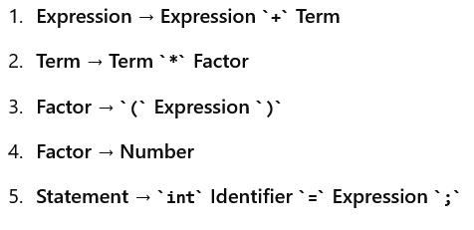
Grammar Rules
The syntax analyzer will use a set of grammar rules to understand the structure of this code. Some possible grammar rules might include
These rules describe how various elements of the language can be combined to form valid statements.

Slide 8
Step 3: Constructing the Parse Tree
The parser will apply these grammar rules to the token stream to construct a parse tree.
For the expression 10 + (5 * 3):
According to the rules, the parser first identifies 5 * 3 as a valid term (using Term → Factor * Factor).
Then, it recognizes (5 * 3) as a valid factor (using Factor → ( Expression )).
Finally, it combines 10 + (5 * 3) as a valid expression (using Expression → Expression + Term).

Slide 9
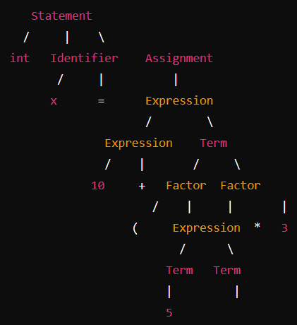
The full parse tree for the statement int x = 10 + (5 * 3); might look like this:

Slide 10
Error Detection
If the code had a syntax error, like a missing semicolon, the parser would be unable to match the tokens to a valid grammar rule, and it would generate a syntax error.
For example, if the code was int x = 10 + (5 * 3, missing the closing parenthesis and semicolon, the parser would fail to complete the parse tree, and an error would be reported.

Slide 11
Semantic Analysis
Ensure that the syntax tree follows the rules of the programming language beyond syntax; it checks for semantic consistency.
The compiler checks for semantic errors like type mismatches, undeclared variables, or incompatible operations.
This phase also involves type checking, where the types of expressions are validated.
Symbol tables are often used to track information about variables, functions, and their attributes.
Output: An annotated syntax tree (often called an abstract syntax tree or AST), with semantic information added.

Slide 12
Key Functions of Semantic Analysis:
Type Checking:
Ensures that operations in the code are semantically valid, meaning that operations are performed on compatible data types.
Symbol Table Management:
The symbol table is a data structure used by the compiler to keep track of identifiers (such as variable names, function names, etc.) and their associated information (e.g., type, scope, memory location).
During semantic analysis, the compiler populates and uses the symbol table to check that variables and functions are declared before they are used, that they are used with the correct types, and that there are no conflicting declarations.
Scope Checking
Ensures that variables and functions are used within their correct scope.
Example: If a variable is declared inside a function and is attempted to be accessed outside that function, the semantic analyzer will detect this error.

Slide 13
Function and Procedure Analysis:
Checks that function calls are made with the correct number and types of arguments, that the return types are consistent with the function's definition, and that procedures (functions without a return value) are used correctly.
Array and String Bounds Checking:
Ensures that arrays and strings are accessed within their defined bounds, preventing out-of-bounds errors at runtime.
Control Flow Analysis:
Analyzes the flow of control in the program to ensure that constructs like loops, conditional statements, and exception handling structures are used correctly.
Example: Detects unreachable code or missing return statements in functions that are supposed to return a value.

Slide 14
int x = 10;
float y = "hello";
int z = x + 3.14;
int func(int a) {
return a + y;
}

